Slide 1
British Airline Customer Review Analysis

Slide 2
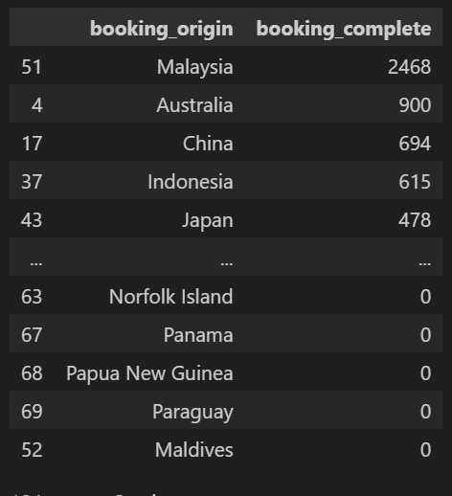
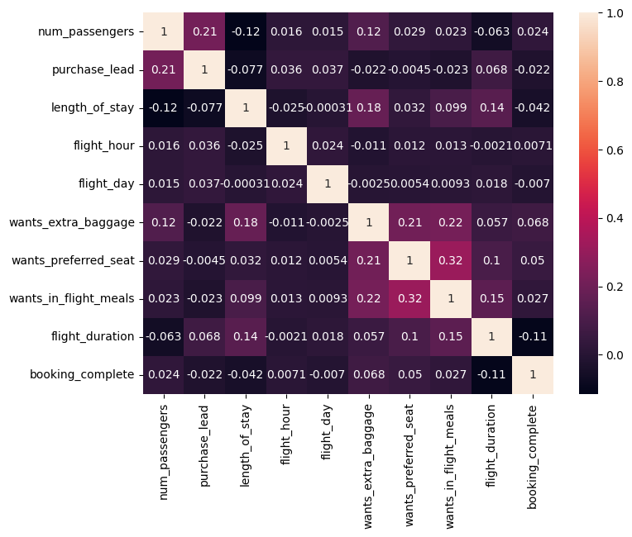
EDA
Origins with most Successful bookings: Correlation Between Features:

Slide 3
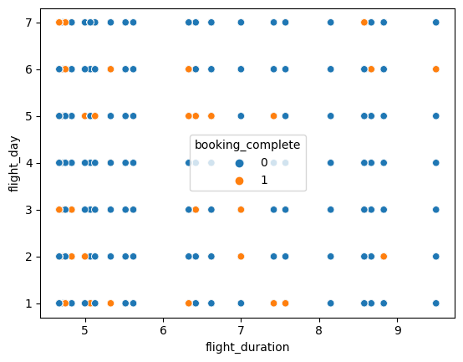
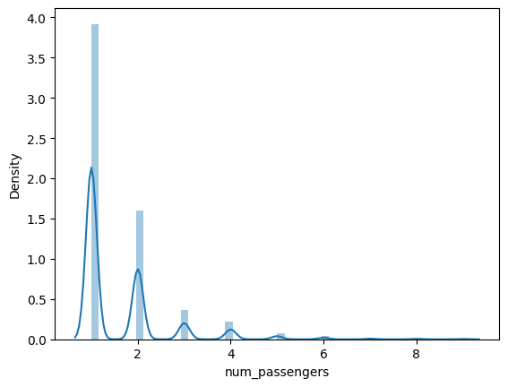
Relationship Between Duration and Day: Distribution of Number of Passnegers:

Slide 4
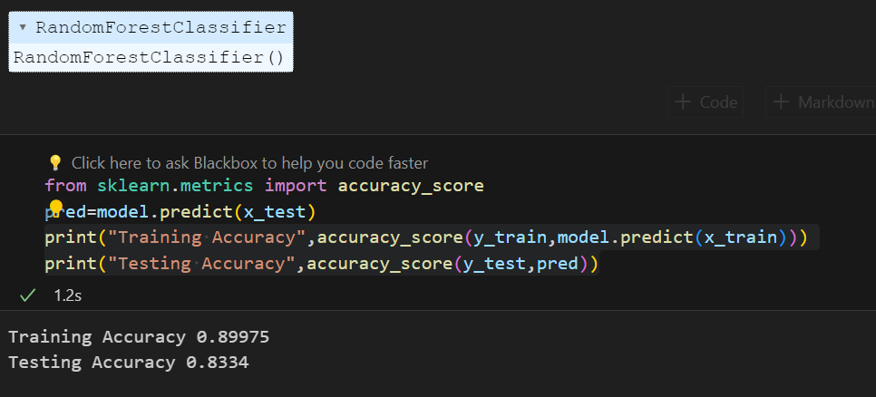
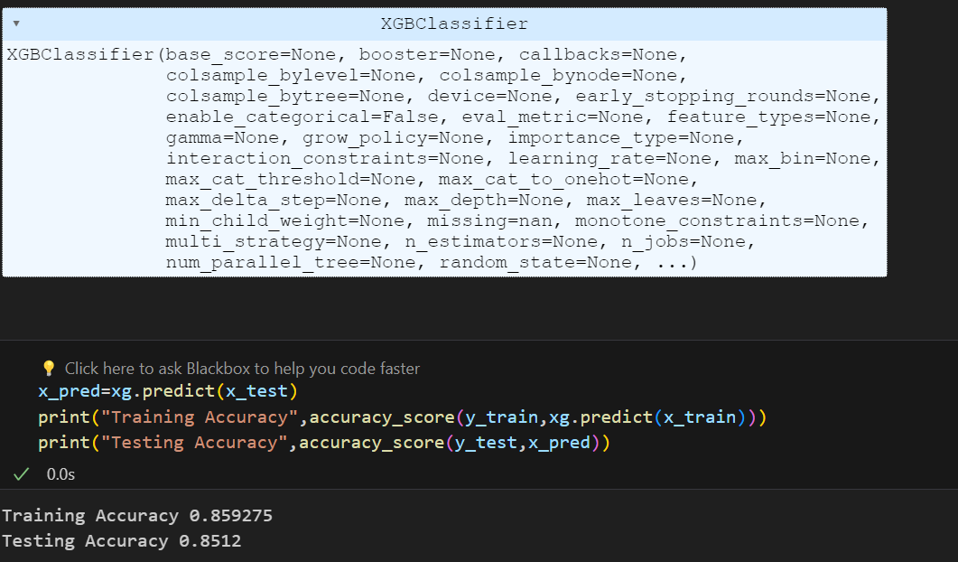
Model
Random Forest Model: XGBoost Classifier:

Slide 5
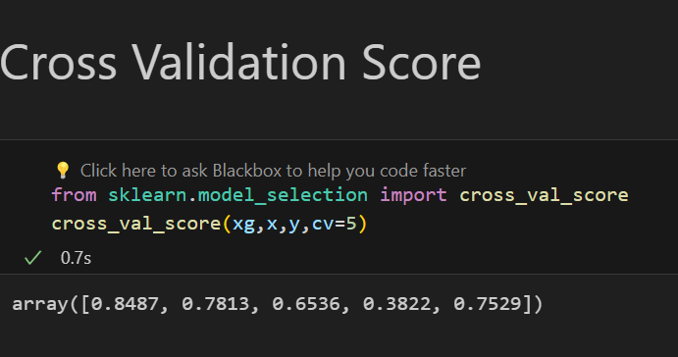
Metrics

